Slide 1
Project in Review
07/07/25 – 29/08/25
Coy Zhu

Slide 2
Literature Review – Week 1
Advances in Medical Image Segmentation: A Comprehensive Review of Traditional, Deep Learning and Hybrid Approaches Yan Xu, Rixiang Quan, Weiting Xu, Yi Huang, Xiaolong Chen and Fengyuan Liu
Whistle-stop tour of Medical Image Segmentation, with traditional techniques like edge-based and region-based segmentation, and modern techniques involving FCNs, RNNs and GANs.
I first heard of the U-Net here.
Use of GANs was briefly explored but is too computationally expensive, since training 2 models at once.
Segment Anything Meta AI Research
Your ViT is Secretly an Image Segmentation Model Tommie Kerssies, Niccolo Cavagnero, Alexander Hermans, Narges Norouzi, Giuseppe Averta, Bastian Leibe, Gijs Dubbelman, Daan de Geus
Transformer based architectures inherently require huge labelled datasets, which we do not have access to.
Natural images weights are not good for medical images, so general foundational models/weights are not super useful.
Medical image analysis using improved SAM‑Med2D: segmentation and classification perspectives Jiakang Sun, Ke Chen, Zhiyi He, Siyuan Ren, Xinyang He, Xu Liu and Cheng Peng
Reached out in hopes of using their SAM-AutoMed segmentation model. Never heard back.

Slide 3
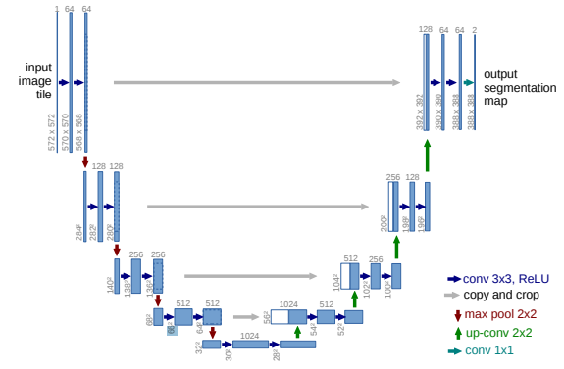
Literature Review – Week 1
U-Net: Convolutional Networks for Biomedical Image Segmentation Olaf Ronneberger, Philipp Fischer, and Thomas Brox

Slide 4
PyTorch Learning – Week 1 & 2
Built several image classifiers using CNNs, via PyTorch tutorials.
Built an image segmenter, via PyTorch tutorials, which used an RCNN. This segmented pedestrians from pictures. Worked very well, with minimal training.
Explored a DCGAN, for generating fake faces, via PyTorch tutorials.
Tried to implement the EoMT from the “Your ViT is Secretly an Image Segmentation Model” paper. Was very difficult and could not fully picture how a vision transformer worked. Abandoned this approach.
Upon looking for FCNs in the PyTorch documentation, there are only FCN ResNets built in.
Started writing an image segmenter using FCN ResNets, following the approximate structure of a PyTorch tutorial for a ResNet classification algorithm.

Slide 5
Basic Architecture Design – Weeks 2 and 3
Continued writing up the code and structure for the FCN ResNet image segmenter.
Regularisation is done via an AdamW optimiser with weight decay, and patience-based early stopping.
A ReduceLROnPlateau learning rate scheduler is used for better generalisation.
In parallel, started processing some of the data given to me by Alex, extracting magnitude and mask data.
This required me to get to grips with how to use Paraview, which my laptop did not handle very well.

Slide 6
Finding Ways to Generate Data – Week 4
Initially misinterpreted signed distance fields as sine distance fields.
Wrote some macros and filters for Paraview, to apply a sinusoidal warp across the data, generating wavy structures.
Some generated data was also corrupted, indicating fragile code.
Never found the reason for this as this method was abandoned.
Explored runpod on Alex’s suggestion.
Using the non-corrupted augmented data, was able to achieve the following results.

Slide 7
Finding Ways to Generate Data – Week 5
Under the clarifications made by Alex in the meeting at the end of Week 4, I set out to find other ways, this time using a signed distance field (SDF).
Spent the week trying to read Alex’s 3D paper.
Got sidetracked and dived into Measure Theory.
Read about weak formulations and FEM.
Looked into using FEniCS to solve the vEikonal equation for arbitrary geometries.
Matthew gave me a textbook to look into about level-set methods.

Slide 8
Generating Synthetic Data – Week 6
Applying the level-set iterative method, began working towards a data generator.
This begins with taking an analytical seed SDFs. In my case, I chose tube and circle shapes, to represent longitudinal and transverse cuts of generic cylindrical vessels.
A random speed field is generated, using a combination of sinusoidal and affine modulations, and random coherent functions sampled from an untrained Gaussian Process (GP).
Iterate the seed SDF with the level-set iterative method, applying the random speed field. This warps the geometry arbitrarily.
The iterative approach can be sped up by using an analytical observation that the SDF gradient magnitude is always 1. Since the number of iterations are low, this is feasible, without the corrections from upwind derivatives.
A np.where() operation is then applied to the SDF to generate the synthetic mask.
A soft Heaviside activation is applied to the SDF, with some masked noise, consisting of the complement of the synthetic mask multiplied with the sum of Gaussian white noise and random coherent noise sampled from an untrained GP.

Slide 9
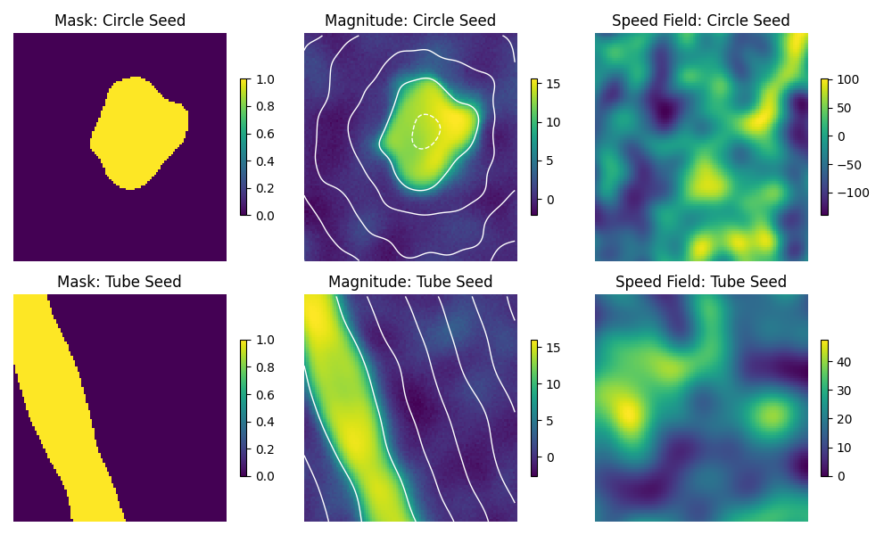
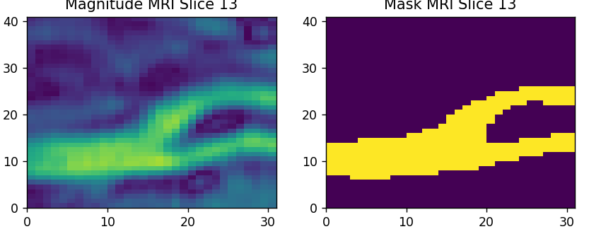
Generating Synthetic Data – Week 6

Slide 10
Generating Synthetic Data – Week 6

Slide 11
Model Selection – Weeks 7 and 8
I wrote the U-Net architecture up in python from scratch and tested it.
In comparison to FCN_ResNet_50 and FCN_ResNet_101, the U-Net suffered far less from exploding gradients, converged faster and generalised much better. These are shown below, in the order mentioned above.

Slide 12
Model Selection – Weeks 7 and 8
Thus far, the approaches have been strictly 2D, treating each slice independently from the next, the reason being that the FCN-ResNet does not support 3D data.
Developed a 3D generalisation of the U-Net. This tackles issues involving the amplification of noise when normalizing an empty slice, whilst also providing another dimension of information.
2D on left, 3D on right.

Slide 13
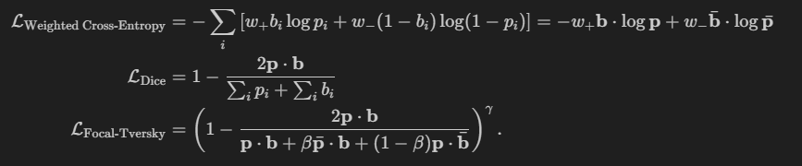
Loss Selection – Week 8
Up until this point, I had been using a Weighted Cross-Entropy + Focal-Tversky combined loss. This was to target foreground segmentation, over background segmentation, otherwise the model would settle into a local minimum of only predicting empty scans.
The Dice loss was also tested early on. Losses shown below.
It turns out that the focal-Tversky loss is prone to exploding gradients.

Slide 14
Next Steps
For 3D purposes, have been using pseudo-3D synthetic data, generated by incremental stepping of SDF. This should be replaced with true 3D synthetic data.
A wider selection of seed SDFs should be used to prevent distributional shifts between synthetic and real data.
More real data would greatly improve generalisation, even just another couple of scans, preferably in vitro, in the validation set would lead to much greater results.
Other architectures could be explored, e.g. the V-Net, which is specific to 3D data.
The U-Net architecture should be refined to be more robust to input data size. It is currently restricted to being a multiple of 16 in all dimensions being convolved (a power for 2 for each octave/level of the U-Net). This can be tackled with cropping, or clever padding.
Loss function parameters could be fine-tuned further. I ran out of time to find the optimal parameter combinations.

